Slide 1
Microservice – 03
Shalini Mittal
Corporate Trainer
Notes:
https://www.elastic.co/guide/en/elasticsearch/reference/7.17/brew.html

Slide 2
Gateway
Notes:
https://www.youtube.com/playlist?list=PLVz2XdJiJQxxWhFkucZBoMxeYE6qTgEF8
https://www.youtube.com/watch?v=lh1oQHXVSc0&list=PLSVW22jAG8pBnhAdq9S8BpLnZ0_jVBj0c
https://www.youtube.com/playlist?list=PLVz2XdJiJQxynOpTm0DuufOkfWHNamJsF
https://www.youtube.com/watch?v=UgirTJiBkV4
https://wankhedeshubham.medium.com/spring-cloud-gateway-pre-and-post-global-filter-global-request-and-response-filter-1378bac33c0e
// http.csrf(AbstractHttpConfigurer::disable) // .authorizeHttpRequests(request -> request.requestMatchers("/api/v1/auth/**") // .permitAll().anyRequest().authenticated()) // .sessionManagement(manager -> manager.sessionCreationPolicy(STATELESS)) // .authenticationProvider(authenticationProvider()).addFilterBefore( // jwtAuthenticationFilter, UsernamePasswordAuthenticationFilter.class); // return http.build();

Slide 3
Without Gateway
Notes:
magine a scenario in which you have to implement a UI for a complex CRM (Customer Relationship Management) application. In order to populate different portions of this UI and perform different user operations, you may have to invoke dozens of microservices. Also, UI has to be aware of the network locations (host and port) of all these microservices. In addition, if the network location of a microservice changes (which tends to happen quite frequently in cloud), UI will also have to be updated. To state the obvious, it’s a very bad design.

Slide 4
With Gateway
Notes:
, a typical web application should have the support for monitoring, authentication, security, CORS and etc. If the UI is directly invoking the microservices, the aforementioned cross cutting concerns should be implemented in each and every microservice separately. A simple change in CORS policy or authentication mechanism would force changes in all the microservices, which is inefficient and error prone.
In order to have a more robust approach, we have to implement a single point of entry or a gateway for all the incoming traffic to microservices. UI will always send requests to the gateway and in turn the gateway will forward the requests to relevant microservices. Essentially, gateway acts as a middle-ware between the UI and the microservices. The following figure illustrates this concept.
The two prime advantages of this approach are as follows.
UI doesn’t need to be aware of the network locations of individual microservices. Instead, UI only needs to know the network location of the gateway. Gateway will route the incoming requests to relevant backend services.
Cross cutting concerns such as authentication, security, monitoring, CORS and etc will be handled by the gateway. Whenever a change is required in any of these aspects, that change can be made in a single place (gateway) to affect all the microservices.

Slide 5
API Gateway
Notes:
, a typical web application should have the support for monitoring, authentication, security, CORS and etc. If the UI is directly invoking the microservices, the aforementioned cross cutting concerns should be implemented in each and every microservice separately. A simple change in CORS policy or authentication mechanism would force changes in all the microservices, which is inefficient and error prone.
In order to have a more robust approach, we have to implement a single point of entry or a gateway for all the incoming traffic to microservices. UI will always send requests to the gateway and in turn the gateway will forward the requests to relevant microservices. Essentially, gateway acts as a middle-ware between the UI and the microservices. The following figure illustrates this concept.
The two prime advantages of this approach are as follows.
UI doesn’t need to be aware of the network locations of individual microservices. Instead, UI only needs to know the network location of the gateway. Gateway will route the incoming requests to relevant backend services.
Cross cutting concerns such as authentication, security, monitoring, CORS and etc will be handled by the gateway. Whenever a change is required in any of these aspects, that change can be made in a single place (gateway) to affect all the microservices.

Slide 6
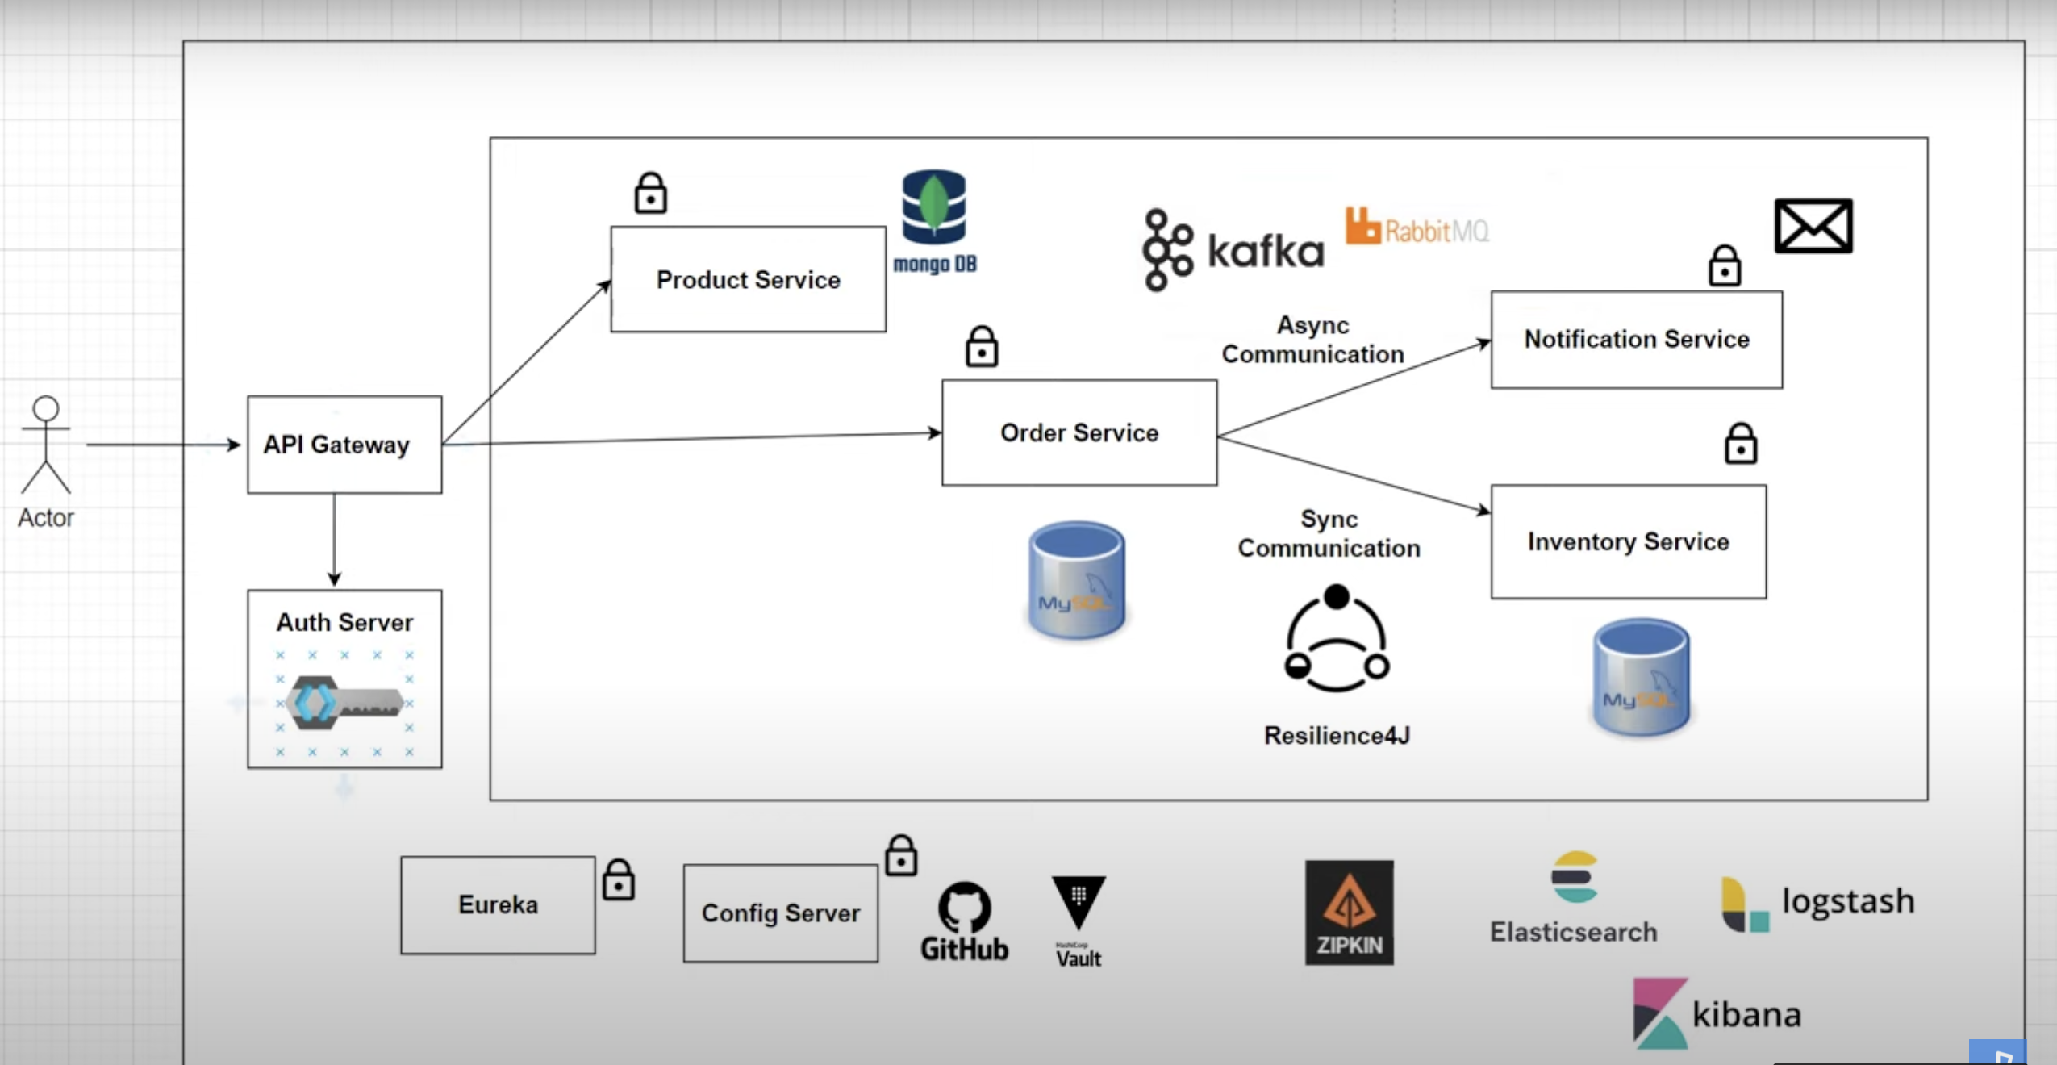
MS Architecture

Slide 7
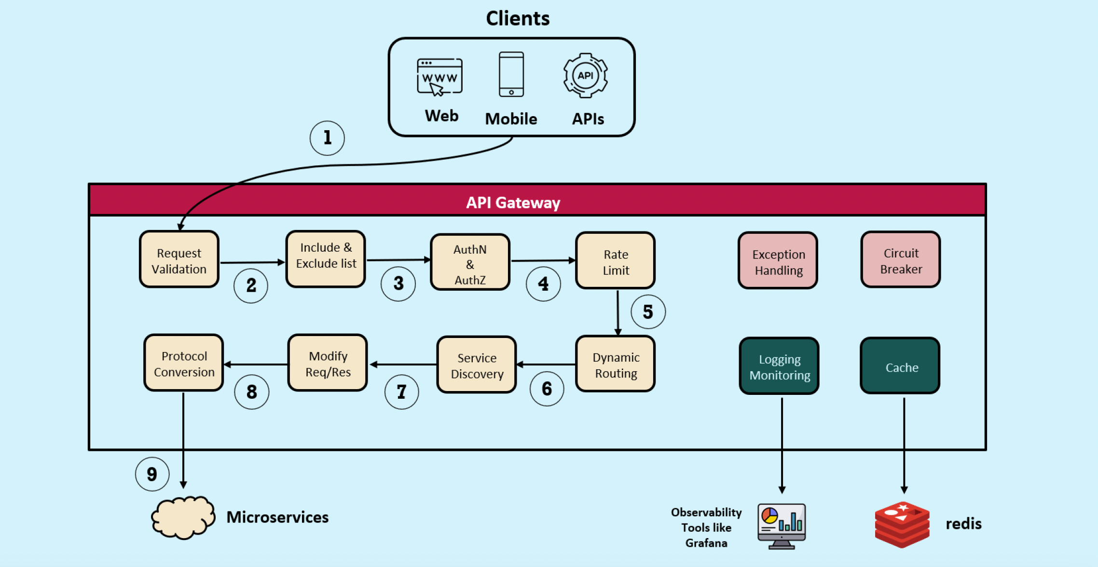
Gateway Tasks

Slide 8
Advantages of API Gateway
The advantages of this approach are as follows-
This improves the security of the microservices as we limit the access of external calls to all our services.
The cross cutting concerns like authentication, monitoring/metrics, and resiliency will be needed to be implemented only in the API Gateway as all our calls will be routed through it.
The client does not know about the internal architecture of our microservices system. Client will not be able to determine the location of the microservice instances.
Simplifies client interaction as he will need to access only a single service for all the requirements.

Slide 9
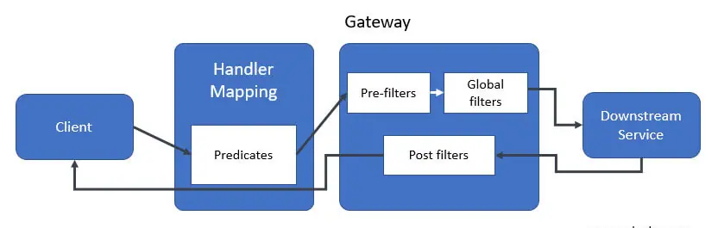
Spring Cloud Gateway
This architecture consists following components are as follows.
Client
Predicates
Mapping handler
Pre-filters
Global filters
Post filters
Downstream service
Notes:
https://exampledriven.wordpress.com/2016/07/06/spring-cloud-zuul-example/
https://www.mscharhag.com/spring/api-gateway-with-spring-cloud-zuul

Slide 10
Spring Cloud Gateway Features
Request Routing: Ability to match routes on any request attribute.
Filtering: Enable you to apply filters specific to routes
Circuit Breaker Integration: Out-of-the-box integration with the Resilience4j circuit breaker.
Spring Cloud DiscoveryClient integration
Easy-to-write Predicates and Filters
Request Rate Limiting: Apply rate limiting for incoming requests.
Path Rewriting: Rewrite the path while routing to blackened endpoints.
WebSocket support
Notes:
So we will need to go through the logs of each service. Also how do we correlate the logs to a request call chain i.e which logs of microservices are related to Request1, which are related to Request2.
https://developer.ibm.com/languages/java/tutorials/monitor-spring-boot-microservices/

Slide 11
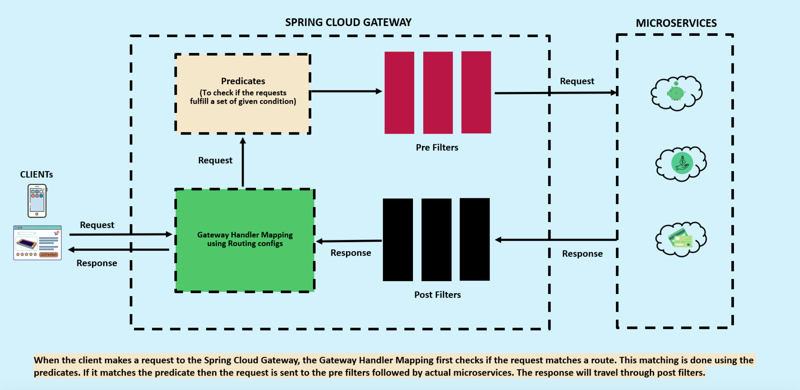
Gateway Internal Architecture
Notes:
So we will need to go through the logs of each service. Also how do we correlate the logs to a request call chain i.e which logs of microservices are related to Request1, which are related to Request2.
https://developer.ibm.com/languages/java/tutorials/monitor-spring-boot-microservices/

Slide 12
Building blocks of Spring Cloud Gateway
Route
The Route is a basic building block of the gateway. It is defined by an ID, a destination URI, a collection of predicates, and a collection of filters. A route is matched if the aggregate predicate is true. Basically, it represents the URL to which incoming request to be forwarded.
Predicate
The Predicate is nothing much more than a Java 8 Function Predicate. The input type is a Spring Framework ServerWebExchange. This lets you match on anything from the HTTP request, such as headers or parameters. In a nutshell, it contains the condition which should match to forward the incoming request to a particular Route URL.
Filter
These are instances of GatewayFilter that have been constructed with a specific factory. Here, you can modify requests and responses before or after sending the downstream request. In simple words, it offers us a provision to modify the incoming request before or after sending it to the Route URL.
Notes:
So we will need to go through the logs of each service. Also how do we correlate the logs to a request call chain i.e which logs of microservices are related to Request1, which are related to Request2.
https://developer.ibm.com/languages/java/tutorials/monitor-spring-boot-microservices/

Slide 13
Route Configurations
Route Define routes to map incoming requests to the appropriate microservices. Routes specify the URI path, filters, and target service. Below is the sample configuration
spring: cloud: gateway: routes: - id: order-service # Unique id of the route. This must be unique uri: http://localhost:8081 #Target microservice URI # uri: lb:ORDER-SERVICE#Target microservice URI as eureka clients predicates: # condition that you want to check before routing to the given URI. - Path=/orders/** # Path predicate for URI path matching
Notes:
So we will need to go through the logs of each service. Also how do we correlate the logs to a request call chain i.e which logs of microservices are related to Request1, which are related to Request2.
https://developer.ibm.com/languages/java/tutorials/monitor-spring-boot-microservices/

Slide 14
Predicates
Predicates define conditions for route matching based on request attributes such as the URI path, headers, or query parameters.
Example:
spring: cloud: gateway: routes: - id: order-service # Unique id of the route. This must be unique uri: http://localhost:8081 #Target microservice URI predicates: # condition that you want to check before routing to the given URI. - Path=/orders/** # Path predicate for URI path matching - Method=GET
Notes:
So we will need to go through the logs of each service. Also how do we correlate the logs to a request call chain i.e which logs of microservices are related to Request1, which are related to Request2.
https://developer.ibm.com/languages/java/tutorials/monitor-spring-boot-microservices/

Slide 15
Global Filters
Configure filters to be applied globally to all routes. These filters are applied to every request that goes through the gateway. Example:
spring: cloud: gateway: globalFilters: - name: RequestRateLimiter args: redis-rate-limiter.replenishRate: 10 redis-rate-limiter.burstCapacity: 20
https://docs.spring.io/spring-cloud-gateway/reference/spring-cloud-gateway.html
Notes:
So we will need to go through the logs of each service. Also how do we correlate the logs to a request call chain i.e which logs of microservices are related to Request1, which are related to Request2.
https://developer.ibm.com/languages/java/tutorials/monitor-spring-boot-microservices/

Slide 16
Gateway Filters
Apply filters to modify requests or responses as they pass through the gateway. Filters can handle tasks such as authentication, authorization, logging, and more
spring: cloud: gateway: routes: - id: order-service # Unique id of the route. This must be unique uri: http://localhost:8081 #Target microservice URI predicates: # condition that you want to check before routing to the given URI. - Path=/orders/** # Path predicate for URI path matching - Method=GET
filters: - StripPrefix=1 # Remove the first segment of the path

Slide 17
Routing
It is a process of identifying a Microservice based on the predicate and URL(Path) and execute it. Generally, there are two types of Routing: Static Routing and Dynamic Routing
Static Routing
If a microservice has a single instance(also known as a direct call to microservice) is known as static routing. In this case API Gateway routes the request directly to the microservice.
Dynamic Routing
Dynamic Routing comes into the picture when a microservice has multiple instances. In this case, API Gateway reaches Eureka, to get less load factor instance and then routes the request to the corresponding microservice. It internally generates Feign Client code based on the given configuration for load balancing.
Notes:
So we will need to go through the logs of each service. Also how do we correlate the logs to a request call chain i.e which logs of microservices are related to Request1, which are related to Request2.
https://developer.ibm.com/languages/java/tutorials/monitor-spring-boot-microservices/

Slide 18
Filters
There are 2 different types of filters.
Pre Filters — if you want to add or change request object before you pass it down to destination service, you can use these filters.
Post Filters — if you want to add or change response object before you pass it back to client, you can use these filters.
Notes:
So we will need to go through the logs of each service. Also how do we correlate the logs to a request call chain i.e which logs of microservices are related to Request1, which are related to Request2.
https://developer.ibm.com/languages/java/tutorials/monitor-spring-boot-microservices/

Slide 19
Gateway Spring Project
Create a spring boot project GatewayServer with following dependencies: eureka client, config client, reactive gateway routing
Update the yml file to get information from config server and register as eureka clients
Add below to tell gateway to connect with gateway server and locate details about microservice. spring : cloud: gateway: discovery: locator: enabled: true
With this run config server, eureka client, gateway server and all the other 3 services.
http://localhost:8072/actuator/gateway/routes [ check for configured paths ]
Notes:
So we will need to go through the logs of each service. Also how do we correlate the logs to a request call chain i.e which logs of microservices are related to Request1, which are related to Request2.
https://developer.ibm.com/languages/java/tutorials/monitor-spring-boot-microservices/

Slide 20
Gateway Default Routing
Test with url as follows on postman : [ make sure the path is upper case as services get registered on eureka in uppercase ] . http://localhost:8072/LOANS/api?mobileNumber=1212121212 http://localhost:8072/CARDS/api?mobileNumber=1212121212 http://localhost:8072/ACCOUNTS/api?mobileNumber=1212121212
Add below to allow for lowercase service id spring : cloud: gateway: discovery: locator: enabled: true lowerCaseServiceId: true
With this rerun gateway server and test with lowercase service name. http://localhost:8072/loans/api?mobileNumber=1212121212 http://localhost:8072/cards/api?mobileNumber=1212121212 http://localhost:8072/accounts/api?mobileNumber=1212121212
Notes:
So we will need to go through the logs of each service. Also how do we correlate the logs to a request call chain i.e which logs of microservices are related to Request1, which are related to Request2.
https://developer.ibm.com/languages/java/tutorials/monitor-spring-boot-microservices/

Slide 21
Custom Routes
The Spring Cloud Gateway uses routes to process requests to downstream services.
Routes can be configured a number of ways:
Add in yml file
Add programmatically
Notes:
https://anjireddy-kata.medium.com/api-gateway-pattern-in-microservices-spring-cloud-api-gateway-85d7f0576af6

Slide 22
Dynamic Routes Programmatically
RouteLocator: It is an interface provided by Spring Cloud Gateway that defines a contract for classes responsible for locating and defining routes.
RouteLocatorBuilder: It is a builder class provided by Spring Cloud Gateway to facilitate the construction of routes fluently and programmatically. It is often used in combination with the RouteLocator interface to define the routing configuration for the API gateway.
Add below in the class with main method:
Test as follows: http://localhost:8072/api?mobileNumber=1212121212
@Bean public RouteLocator eazyBankRouteConfig(RouteLocatorBuilder routeLocatorBuilder) { return routeLocatorBuilder.routes() .route(p -> p .path("/api/**") .uri("lb://LOANS")) .build(); }
Notes:
https://anjireddy-kata.medium.com/api-gateway-pattern-in-microservices-spring-cloud-api-gateway-85d7f0576af6
https://anjireddy-kata.medium.com/spring-cloud-gateway-dynamic-route-configuration-and-loading-from-the-datastore-a0637e6bd9b4

Slide 23
Rewrite Path
To configure routes for different services and rewrite the path for the same, update route config method as follow:
Add below in the class with main method:
return routeLocatorBuilder.routes() .route(p -> p .path(" ("/eazybank/accounts/**") .filters( f -> f.rewritePath("/eazybank/accounts/(?<segment>.*)","/${segment}")) .uri("lb://ACCOUNTS"))
.route(p -> p .path("/eazybank/loans/**") .filters( f -> f.rewritePath("/eazybank/loans/(?<segment>.*)","/${segment}")) .uri("lb://LOANS")) .route(p -> p .path("/eazybank/cards/**") .filters( f -> f.rewritePath("/eazybank/cards/(?<segment>.*)","/${segment}")) .uri("lb://CARDS")).build();
Notes:
https://anjireddy-kata.medium.com/api-gateway-pattern-in-microservices-spring-cloud-api-gateway-85d7f0576af6
https://anjireddy-kata.medium.com/spring-cloud-gateway-dynamic-route-configuration-and-loading-from-the-datastore-a0637e6bd9b4

Slide 24
Dynamic Routes Test
Rerun the gateway server and test the following on the postman http://localhost:8072/eazybank/accounts/api?mobileNumber=1212121312 http://localhost:8072/accounts/api?mobileNumber=1212121312
You will see both links work as gateway server is getting both routes from eureka server.
Check below route configuration: http://localhost:8072/actuator/gateway/routes
You will see both the routes.
Just make the discover.server.locator.enabled as false.
Rerun and now only /eazybank/accounts link should work
Notes:
The RewritePath GatewayFilter factory takes a path regexp parameter and a replacement parameter. This uses Java regular expressions for a flexible way to rewrite the request path
For a request path of /red/blue, this sets the path to /blue before making the downstream request. Note that the $ should be replaced with $\ because of the YAML specification.

Slide 25
Add Built In filters
To add a header in the response
return routeLocatorBuilder.routes() .route(p -> p .path("/eazybank/accounts/**") .filters( f -> f.rewritePath("/eazybank/accounts/(?<segment>.*)","/${segment}") .addResponseHeader("X-Response-Time", LocalDateTime.now().toString())) .uri("lb://ACCOUNTS")) .route(p -> p .path("/eazybank/loans/**") .filters( f -> f.rewritePath("/eazybank/loans/(?<segment>.*)","/${segment}") .addResponseHeader("X-Response-Time", LocalDateTime.now().toString())) .uri("lb://LOANS")) .route(p -> p .path("/eazybank/cards/**") .filters( f -> f.rewritePath("/eazybank/cards/(?<segment>.*)","/${segment}") .addResponseHeader("X-Response-Time", LocalDateTime.now().toString())) .uri("lb://CARDS")).build();
https://docs.spring.io/spring-cloud-gateway/reference/spring-cloud-gateway/gatewayfilter-factories/addresponseheader-factory.html#page-title
Notes:
The RewritePath GatewayFilter factory takes a path regexp parameter and a replacement parameter. This uses Java regular expressions for a flexible way to rewrite the request path
For a request path of /red/blue, this sets the path to /blue before making the downstream request. Note that the $ should be replaced with $\ because of the YAML specification.

Slide 26
Add Custom filter
Since all calls to the application are routed via API gateway it also grants us the distinct ability to be able to intercept all incoming & outgoing calls to and from all microservices within the scope of the application.
This can be achieved by implementing any of the following filters, each providing varied degrees of coverage
Global filter — conditionally applied to all routes except the endpoints hosted within the API gateway
Gateway filter — applied to specific configured routes
Web filter — applied to all routes inclusive of endpoints hosted within the API gateway
The ServerWebExchange method argument of the filter method encapsulates both request and response pertaining to this invocation
Notes:
https://medium.com/spring-boot/spring-cloud-api-gateway-filters-fca80f96fd26

Slide 27
Add Circuit Breaker
The way filters can be added same way resilience4j modules can also be added.
Add below dependency: <dependency> <groupId>org.springframework.cloud</groupId> <artifactId>spring-cloud-starter-circuitbreaker-reactor-resilience4j</artifactId> </dependency>
Configure default CD configuration:
Add circuit breaker within routes:
resilience4j.circuitbreaker: configs: default: slidingWindowSize: 10 permittedNumberOfCallsInHalfOpenState: 2 failureRateThreshold: 50 waitDurationInOpenState: 5s
.filters( f -> f.rewritePath("/eazybank/accounts/(?<segment>.*)","/${segment}") .addResponseHeader("X-Response-Time", LocalDateTime.now().toString()) .circuitBreaker(config -> config.setName("accountsCircuitBreaker") .setFallbackUri("forward:/contactSupport"))) .uri("lb://ACCOUNTS"))
Notes:
https://medium.com/spring-boot/spring-cloud-api-gateway-filters-fca80f96fd26

Slide 28
References
https://www.youtube.com/watch?v=mPPhcU7oWDU&t=15066s
Notes:
https://www.journaldev.com/8195/spring-boot-cli-setup-and-helloworld-example

